Slide 1
Digital Portfolio
STUDENT NAME: YAZHINI K
REGISTER NO AND NMID: 2428C0528 &
C48C57479461B10B46644A3B7090C889
DEPARTMENT: B.Sc - AIML
COLLEGE: KPR COLLEGE/ BHARATHIYAR UNIVERSITY

Slide 2
PROJECT TITLE
Travel Blogger Portfolio Website.

Slide 3


AGENDA
Problem Statement
Project Overview
End Users
Tools and Technologies
Portfolio design and Layout
Features and Functionality
Results and Screenshots
Conclusion
Github Link
3/21/2024 Annual Review

Slide 4

PROBLEM STATEMENT
The main objective of the Travel Blogger Portfolio project is to design and develop a personalized digital space where a travel blogger can showcase their journeys, experiences, and creative content in a visually appealing and professional manner.
This portfolio will serve as both a personal brand identity and a storytelling platform, enabling the blogger to connect with a global audience. It highlights their travels through images, blogs, and videos while also making it easier for followers, collaborators, and travel agencies to reach out.

Slide 5

PROJECT OVERVIEW
Create a personal website to showcase travel stories, blogs, photos, and videos. Highlight the blogger’s identity with sections like About, Gallery, Blog, Vlogs, and Contact. Use HTML, CSS, and JavaScript with responsive design and smooth animations. Attract travel enthusiasts, followers, and potential collaborators through engaging content. Deliver a professional, user-friendly portfolio that boosts branding and opportunities.

Slide 6

WHO ARE THE END USERS?
Travel Enthusiasts – People who love exploring new places and get inspired by the blogger’s experiences. Followers & Fans – Regular readers/viewers who follow the blogger’s journeys through blogs, photos, and vlogs. Tourism Companies & Travel Agencies – Businesses that may want to collaborate for promotions, partnerships, or sponsored trips. Hotels, Airlines, & Brands – Potential partners looking for influencer marketing opportunities. General Audience – Anyone searching online for travel tips, destination guides, or inspiration.

Slide 7

TOOLS AND TECHNIQUES
HTML CSS JavaScript Git and GitHub VS Code

Slide 8
PORTFOLIO DESIGN AND LAYOUT
Header & Navigation – Sticky top bar with logo on the left and navigation links (About, Journal, Projects, Contact) on the right. Hero Section – Full-screen background image/video with intro text (Name, Tagline) and a call-to-action button. About & Travel Journal – About Me card with details, followed by a grid of travel cards showing photos, titles, and short trip stories. Projects & Contact – Project highlights in card layout, plus a contact form with social media links. Footer – Minimal footer with copyright text and a clean background accent.
8

Slide 9
FEATURES AND FUNCTIONALITY
Interactive Navigation – Sticky header with smooth scroll to different sections for easy access. Travel Journal & Gallery – Grid-based cards with images, titles, and short stories; hover animations and optional lightbox/full-view. Projects Showcase – Highlight travel-related works (route planner, photography series, food guide) with interactive project cards. Contact Form & Social Links – Functional form for messages (demo/real integration) and quick access to Instagram, YouTube, or email. Responsive & Animated UI – Mobile-friendly design with 3D tilt, hover effects, and smooth transitions for an engaging experience.

Slide 10
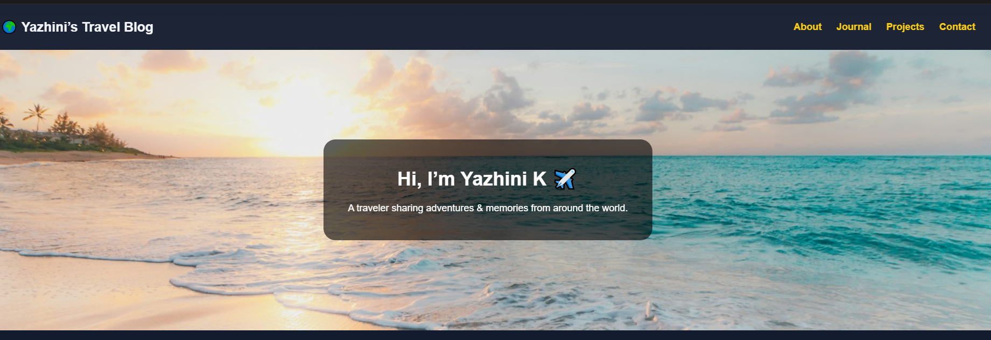
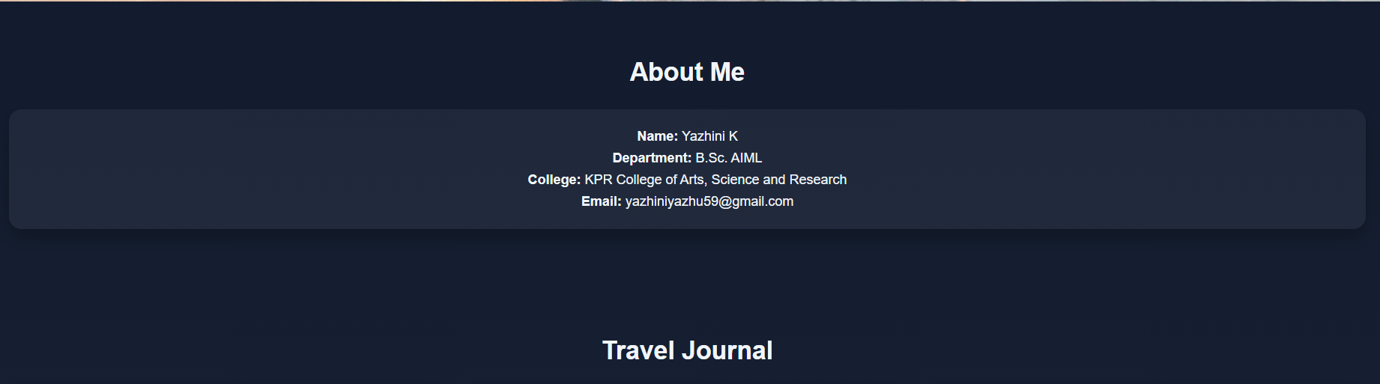

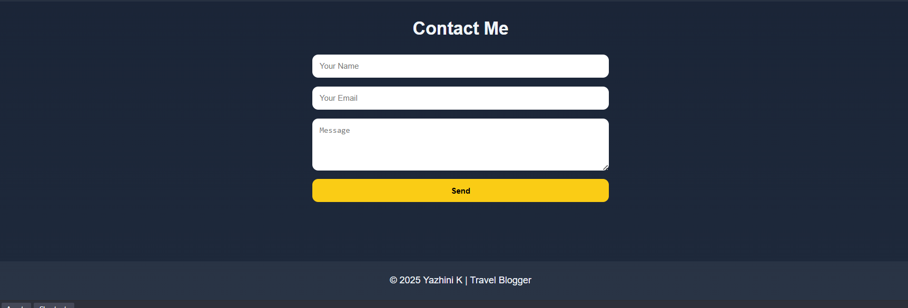
RESULTS AND SCREENSHOTS
3/21/2024 Annual Review
10

Slide 11
GITHUB LINK
https://github.com/yazhini21-ai/blogger-portfolio.git

Slide 12
CONCLUSION
Highlights my sports skills and career achievements Summarizes my journey, milestones, and dedication to the game Helps coaches, teams, and sponsors understand my potential Makes it easier for scouts, managers, and supporters to connect with me
12

